Slide 1
Exam Preparation & Building a Computer
CSE 390B, Spring 2022
Lecture 9: Exam Preparation & Building a Computer
Exam Preparation, Overview of Building a Computer, Hack CPU Logic

Slide 2
Lecture Outline
Exam Preparation
Study Strategies, Mock Exam Problem
Overview of Building a Computer
Architecture, Fetch and Execute Cycle
Hack CPU Logic
Implementation and Operations

Slide 3
Gearing Up For Exams
Make a Study Plan
What key topics / concepts does your exam cover?
How might your study guides look different for specific classes?
What resources, materials, or people might you engage with?
Create a Schedule
Do not cram
Office hours, review sessions, study groups
Reference your weekly time commitments & quarterly calendar
Test Yourself
What are ways that can help address this?
Replicate exam-like environments

Slide 4
Exams Preparation Discussion
How do you usually prepare for your exams?
What is one thing that is effective and ineffective about the way you study? Why?
What are some effective exam preparation strategies that you would find most helpful?
How might you implement some of these effective strategies for change your exam preparation strategy for this quarter?

Slide 5
Project 6, Part I: Mock Exam Problem
Schedule a 30-minute session based on your group members availability to do one mock exam problem
Determine how you will connect with each other
Determine where your session will be located
Comment your group’s meeting day and time on the Project 6 Mock Exam Groups spreadsheet
We will make an Ed post with this spreadsheet

Slide 6
Lecture Outline
Exam Preparation
Study Strategies, Mock Exam Problem
Overview of Building a Computer
Architecture, Fetch and Execute Cycle
Hack CPU Logic
Implementation and Operations

Slide 7
Building a Computer
All your hardware efforts are about to pay off!
Perspective: BUILDING A COMPUTER
In Project 6, you will build Computer.hdl, the final, top-level chip in this course
For all intents and purposes, a real computer
Simplified, but organization very similar to your laptop
Project 7 onward, we will write software to make it useful

Slide 8

Von Neumann Architecture
COMPUTER
MEMORY
CPU
0
1
2
0101110011100110
1011000101010100
1110001011111100
...
Instructions
INPUT
OUTPUT
n
n+1
n+2
1100101010010101
1100100101100111
0011001010101011
...
Data
REGISTERS
CONTROL

Slide 9
Connecting the Computer: Buses
COMPUTER
MEMORY
CPU
0
1
2
0101110011100110
1011000101010100
1110001011111100
...
Instructions
INPUT
OUTPUT
n
n+1
n+2
1100101010010101
1100100101100111
0011001010101011
...
Data
REGISTERS
CONTROL
Control Bus
Address Bus
Data Bus

Slide 10
Basic CPU Loop
Repeat forever:
Fetch an instruction from the program memory
Execute that instruction

Slide 11
Fetching
Specify which instruction to read as the address input to our memory
Data output: actual bits of the instruction
MEMORY
Memory Output: Data
Instruction
D=A;JMP
0
1
2
0101110011100110
1011000101010100
1110001011111100
...
Instructions
n
n+1
n+2
1100101010010101
1100100101100111
0011001010101011
...
Data
Memory Input: Address
Instruction Address
PC
1

Slide 12
Executing
The instruction bits describe exactly “what to do”
A-instruction or C-instruction?
Which operation for the ALU?
What memory address to read? To write?
Should I jump after this instruction, and if so, where?
Executing the instruction involves data of some kind
Accessing registers
Accessing memory

Slide 13
Combining Fetch & Execute
MEMORY
Memory Output: Data
Instruction
D=A;JMP
0
1
2
0101110011100110
1011000101010100
1110001011111100
...
Instructions
Data
245
n
n+1
n+2
1100101010010101
1100100101100111
0011001010101011
...
Data
Memory Input: Address
Instruction Address
PC
1
Data Address (From instruction or register)

Slide 14
Combining Fetch & Execute
MEMORY
Memory Output: Data
Could we implement with RAM16K.hdl?
Instruction
D=A;JMP
0
1
2
0101110011100110
1011000101010100
1110001011111100
...
Instructions
Data
245
n
n+1
n+2
1100101010010101
1100100101100111
0011001010101011
...
Data
Memory Input: Address
Instruction Address
PC
1
Data Address (From instruction or register)

Slide 15
Combining Fetch & Execute
MEMORY
Memory Output: Data
Could we implement with RAM16K.hdl?
No! Our memory chips only have one address input and one output
Instruction
D=A;JMP
0
1
2
0101110011100110
1011000101010100
1110001011111100
...
Instructions
Data
245
n
n+1
n+2
1100101010010101
1100100101100111
0011001010101011
...
Data
Memory Input: Address
Instruction Address
PC
1
Data Address (From instruction or register)

Slide 16
Solution 1: Fetching / Executing Separately
Memory Output: Data
Instruction, when fetching
Can use multiplexing to share a single input or output
MEMORY
0
1
2
0101110011100110
1011000101010100
1110001011111100
...
Instructions
DMux
Data, when executing
Fetching vs. Executing
n
n+1
n+2
1100101010010101
1100100101100111
0011001010101011
...
Data
Memory Input: Address
Instruction Address
Mux
Data Address
Fetching vs. Executing

Slide 17
Solution 1: Fetching / Executing Separately
Fetching vs. Executing
Memory Output: Data
Instruction, when fetching
Need to store fetched instruction so it’s available during execution phase
MEMORY
Register
0
1
2
0101110011100110
1011000101010100
1110001011111100
...
Instructions
DMux
Data, when executing
Fetching vs. Executing
n
n+1
n+2
1100101010010101
1100100101100111
0011001010101011
...
Data
Memory Input: Address
Instruction Address
Mux
Data Address
Fetching vs. Executing

Slide 18
Solution 2: Separate Memory Units
Separate instruction memory and data memory into two different chips
Each can be independently addressed, read from, written to
Pros:
Simpler to implement
Cons:
Fixed size of each partition, rather than flexible storage
Two chips → redundant circuitry

Slide 19
Five-minute Break!
Feel free to stand up, stretch, use the restroom, drink some water, review your notes, or ask questions
We’ll be back at:
Research shows mid-lecture breaks reduce the decline of attention in the middle of lecture (Olmsted, 1999)
Olmsted III, John. “The Mid-Lecture Break: When Less Is More.” Journal of Chemical Education (1999). https://pubs.acs.org/doi/abs/10.1021/ed076p525.

Slide 20
Lecture Outline
Exam Preparation
Study Strategies, Mock Exam Problem
Overview of Building a Computer
Architecture, Fetch and Execute Cycle
Hack CPU Logic
Implementation and Operations

Slide 21
Which of the following statements about the Hack CPU is FALSE?
The Mux and ALU output is connected to the A register because it’s a possible destination from a C instruction
The A register and the M pseudo-register are never involved in a computation together
writeM determines whether the value should be updated in memory at addressM to outM
We feed the A register’s output to the PC because this is the value that we increment
We’re lost…

Slide 22
Hack CPU
COMPUTER
ROM
(Instructions)
CPU
RAM
(Data)
instr
data out
0
1
2
010111001110
101100010101
111000101111
...
Instructions
0
1
2
100110010111
100011001111
000000000010
...
Data
addr of next instruction
REGISTERS
data in
CONTROL
INPUT
OUTPUT

Slide 23
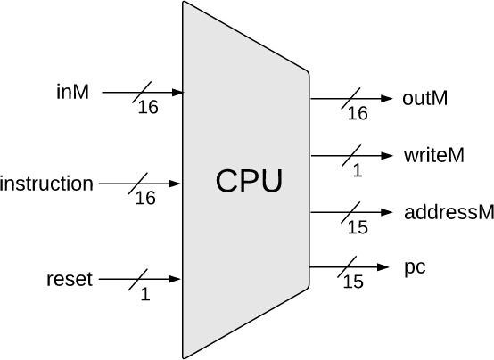
Hack CPU Interface Inputs
inM: Value coming from memory
instruction: 16-bit instruction
reset: if 1, reset the program

Slide 24
Hack CPU Interface Outputs
outM: value used to update memory if writeM is 1
writeM: if 1, update value in memory at addressM with outM
addressM: address to read from or write to in memory
pc: address of next instruction to be fetched from memory

Slide 25
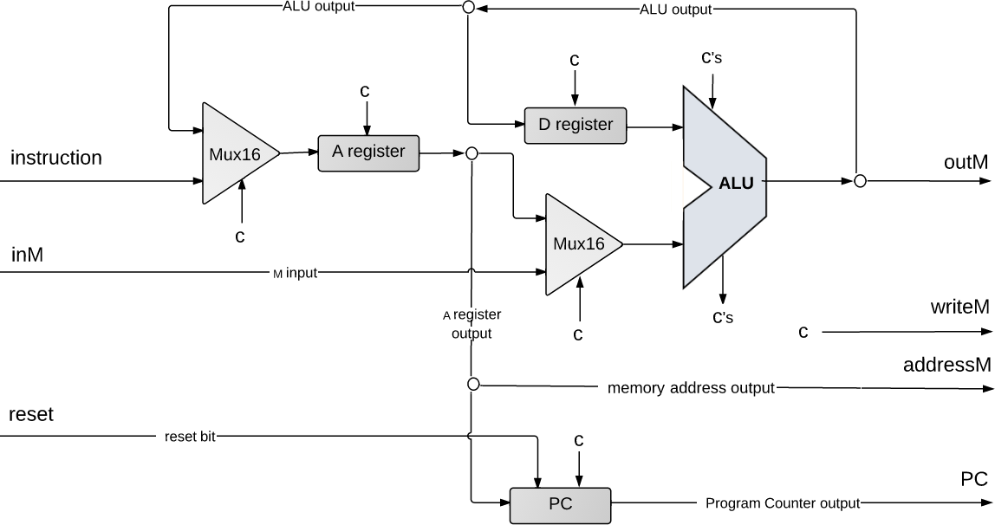
Hack CPU Implementation
pc

Slide 26
Hack CPU Implementation
(each "C" symbol represents a control bit)

Slide 27
CPU Operation: Instruction Handling
(each "C" symbol represents a control bit)

Slide 28
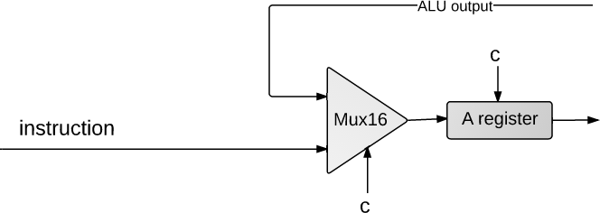
CPU Operation: Instruction Handling
@5
0000000000000101
A-instruction

Slide 29
CPU Operation: Instruction Handling
@5
0000000000000101
A-instruction
CPU handling of an A-instruction:
Decodes the instruction into:
op-code
15-bit value
Stores the value in the A-register
Outputs the value (not shown in this diagram)

Slide 30
CPU Operation: Instruction Handling
C-instruction
D=D+1;JMP
1110011111010111

Slide 31
CPU Operation: Instruction Handling
C-instruction
D=D+1;JMP
1110011111010111
CPU handling of a C-instruction:
Decodes the instruction bits into:
Op-code
ALU control bits
Destination load bits
Jump bits
Routes these bits to their chip-part destinations
The chip-parts (most notably, the ALU) execute the instruction

Slide 32
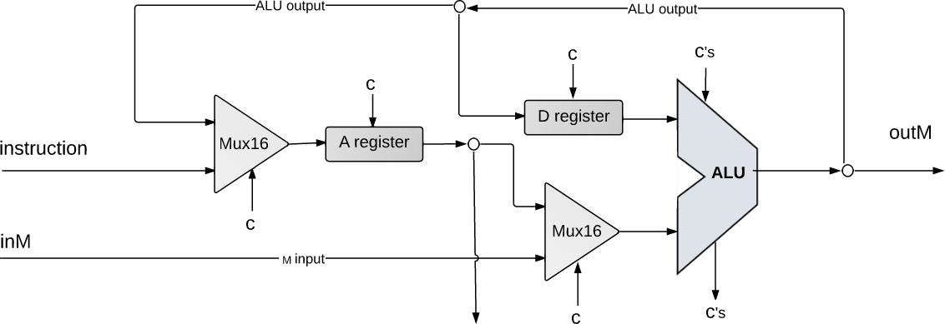


CPU Operation: Handling C-Instructions
011111
1…01
1110011111010111
1…10
writeM
ALU data inputs:
Input 1: from the D-register
Input 2: from either:
A-register, or
data memory
ALU control inputs:
Control bits (from the instruction)

Slide 33








CPU Operation: Handling C-Instructions
1
011111
0
1…01
0…11
1110011111010111
1…10
writeM
0
ALU data output:
Result of ALU calculation
Fed simultaneously to: D-register, A-register, data memory
Which destination actually commits to the ALU output is determined by the instruction’s destination bits

Slide 34
CPU Operation: Handling C-Instructions
011111
1…01
0…11
1110011111010111
1…10
writeM
ALU control outputs:
Is the output negative?
Is the output zero?

Slide 35
CPU Operation: Control
pc

Slide 36
CPU Operation: Control

Slide 37
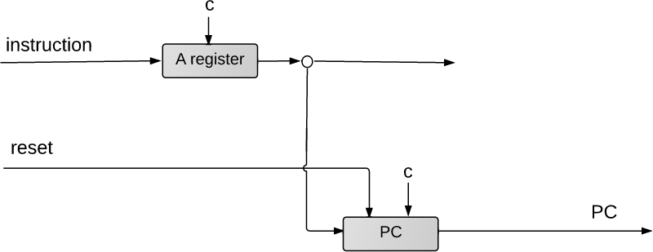
CPU Operation: Control
16
load
1
pc
PC operation (abstraction)
Outputs the address of the next instruction:
Restart: PC = 0
No jump: PC++
Go to: PC = A
Conditional go to: if (condition) PC = A
else PC ++
16
address of next
instruction

Slide 38
CPU Operation: Control
111 a c c c c c c d d d j j j
16
load
1
pc
16
PC operation (implementation)
if (reset==1) PC = 0
else
// In the course of handling the current instruction:
load = f (jump bits, ALU control outputs)
if (load == 1) PC = A // jump
else PC++ // next instruction
Address of next instruction

Slide 39
Hack CPU Implementation: That’s It!

Slide 40
Lecture 9 Wrap-up
Project Reminders
Project 5 due Thursday (4/28) at 11:59pm PDT
CSE 390B Midterm Exam next Thursday (5/5) during lecture
No reading for this Thursday’s lecture

